Slide 1
MOSc manuscript correction
Hazwani Danil, 4/6/2025

Slide 2
Result-
Mean and range follow-up for PAMR, RAM cases
Expanded descriptive stats according to references paper.

Slide 3

Variable |  | Mean | SD | Min | Max
Follow-up period | AMNR | 12.59 | 3.14 | 5 | 16
 | RAM | 6.85 | 4.9 | 2 | 20
Nak value of mean follow-up time, range follow-up time for both.
Tak pasti perlu SD ke untuk follow up period.

Slide 4
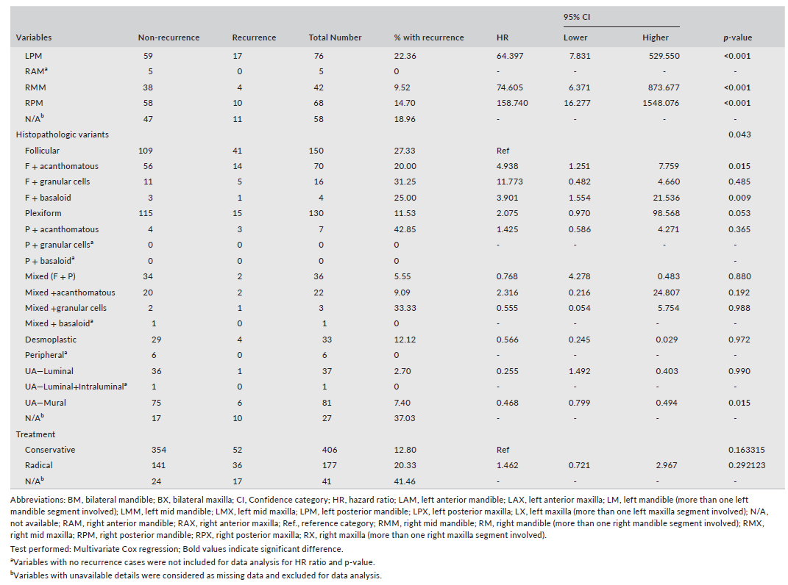

Slide 5
Variables |  | Category
 |  |  | AMNR | PAMR | RAM
 |  |  | N= 16(%) | N=13 (%) | N=13 (%)
Gender | Male |  | 12 (75.0) | 3 (23.1) | 3 (23.1)
 | Female |  | 4 (25.0) | 10 (76.9) | 10 (76.9)
 | M:F ratio |  | 3:1 | 1:3.3
Age | 10-19 years |  | 5(31.25) | 1 (7.7) | 0 (0.0)
 | 20-29 years |  | 5(31.25) | 3 (23.1) | 2 (15.4)
 | 30-39 years |  | 1(6.25) | 3(23.1) | 4(30.8)
 | 40-49 years |  | 1(6.25) | 3(23.1) | 3(23.1)
 | 50-59 years |  | 3(18.75) | 2(15.4) | 2(15.4)
 | 60-69 years |  | 1(6.25) | 1(7.7) | 1(7.7)
 | 70-79 years |  | 0 | 0 | 1(7.7)
 | Mean age |  | 31.3 | 37.2 | 44
 | Age range |  | 12-62 | 14-64 | 22-72
Known site of occurrence | Side | Right | 7 (43.8) | 8 (61.5) | 9 (69.2)
 |  | Left | 4 (25.0) | 4 (30.8) | 4 (30.8)
 |  | Bilateral | 5 (31.2) | 1 (7.7) | 0 (0.0)
 | Subsite(s) | Anterior | 1 (6.3) | 1 (7.7) | 1 (7.7)
 |  | Middle | 0 (0.0) | 0 (0.0) | 0 (0.0)
 |  | Posterior | 2 (12.5) | 5 (38.5) | 6 (46.1)
 |  | Mandible | 5 (31.2) | 4 (30.8) | 3 (23.1)
 |  | Bilateral | 5 (31.2) | 1 (7.7) | 0 (0.0)
 |  | Non specified | 3 (18.8) | 2 (15.3) | 3 (23.1)
Known treatment |  | Conservative | 6 (37.5) | 11(84.6) | 2 (15.4)
 |  | Radical | 9 (56.3) | 1 (7.7) | 10 (76.9)
 |  | Non specified | 1 (6.2) | 1 (7.7) | 1(7.7)
Known ameloblastoma histopathological variant |  | Follicular | 5 (31.3) | 8 (61.5) | 6 (46.1)
 |  | Plexiform | 9 (56.3) | 3 (23.1) | 3 (23.1)
 |  | Acanthomatous | 1 (6.2) | 0 (0.0) | 0 (0.0)
 |  | Basal cell | 0 (0.0) | 0 (0.0) | 1(7.7)
 |  | Mixed type | 1 (6.2) | 2 (15.4) | 3 (23.1)
Refer Excel Tab - LatestOutput
Nak follow mcm table stats sebelah. Add on % with recurrence, follow-up duration, HR (hazard ratio)- tak sure kita punya boleh letak ke tak. 95% CI (lower & higher), p-value. If possible najmi run stats pastu terus letak dalam table nanti saya edit.

Slide 6
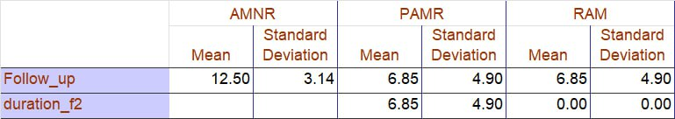
Demographic and clinicopathological characteristics- descriptive analysis
Variables |  | Category
 |  |  | AMNR | PAMR | RAM
 |  |  | N= 16(%) | N=13 (%) | N=13 (%)
Gender | Male |  | 12 (75.0) | 3 (23.1) | 3 (23.1)
 | Female |  | 4 (25.0) | 10 (76.9) | 10 (76.9)
 | M:F ratio |  | 3:1 | 1:3.3
Age | 10-19 years |  | 5(31.25) | 1 (7.7) | 0 (0.0)
 | 20-29 years |  | 5(31.25) | 3 (23.1) | 2 (15.4)
 | 30-39 years |  | 1(6.25) | 3(23.1) | 4(30.8)
 | 40-49 years |  | 1(6.25) | 3(23.1) | 3(23.1)
 | 50-59 years |  | 3(18.75) | 2(15.4) | 2(15.4)
 | 60-69 years |  | 1(6.25) | 1(7.7) | 1(7.7)
 | 70-79 years |  | 0 | 0 | 1(7.7)
 | Mean age |  | 31.3 | 37.2 | 44
 | Age range |  | 12-62 | 14-64 | 22-72
Known site of occurrence | Side | Right | 7 (43.8) | 8 (61.5) | 9 (69.2)
 |  | Left | 4 (25.0) | 4 (30.8) | 4 (30.8)
 |  | Bilateral | 5 (31.2) | 1 (7.7) | 0 (0.0)
 | Subsite(s) | Anterior | 1 (6.3) | 1 (7.7) | 1 (7.7)
 |  | Middle | 0 (0.0) | 0 (0.0) | 0 (0.0)
 |  | Posterior | 2 (12.5) | 5 (38.5) | 6 (46.1)
 |  | Mandible | 5 (31.2) | 4 (30.8) | 3 (23.1)
 |  | Bilateral | 5 (31.2) | 1 (7.7) | 0 (0.0)
 |  | Non specified | 3 (18.8) | 2 (15.3) | 3 (23.1)
Known treatment |  | Conservative | 6 (37.5) | 11(84.6) | 2 (15.4)
 |  | Radical | 9 (56.3) | 1 (7.7) | 10 (76.9)
 |  | Non specified | 1 (6.2) | 1 (7.7) | 1(7.7)
Known ameloblastoma histopathological variant |  | Follicular | 5 (31.3) | 8 (61.5) | 6 (46.1)
 |  | Plexiform | 9 (56.3) | 3 (23.1) | 3 (23.1)
 |  | Acanthomatous | 1 (6.2) | 0 (0.0) | 0 (0.0)
 |  | Basal cell | 0 (0.0) | 0 (0.0) | 1(7.7)
 |  | Mixed type | 1 (6.2) | 2 (15.4) | 3 (23.1)
Kita tambah bawah known treatment tu, Duration to recurrence. Untuk AMNR takde, just between PAMR dengan RAM- rujuk dekat main data
AMNR PAMR RAM
mean(SD)
Duration to recurrence - 12.50(3.14) 0

Slide 7
Association between IL-1α, IL-6 and CD 10 expression levels with histopathological variants in AMNR, PAMR and RAM
Nak kena expand table 5 ni, refine untuk IL-alpha yang ada statistical significant. Nak determine which variant yang actually ada significant dengan marker tu.
Consider collapsing categories for more reliable results. Chi-squared statistic (overall): 36.7649 P-value (overall): 0.1841 Conclusion: There is no overall statistically significant association between Category_subtype and IL1a intensity (p >= 0.05).

